Slide 1
Projectile Motion Lesson
Mr. Barker

Slide 2
Angry Birds need your help.

Slide 3
Solution
The vertex is at (6.5, 11)

Slide 4

Solution
Solve for A and plug it in.

Slide 5
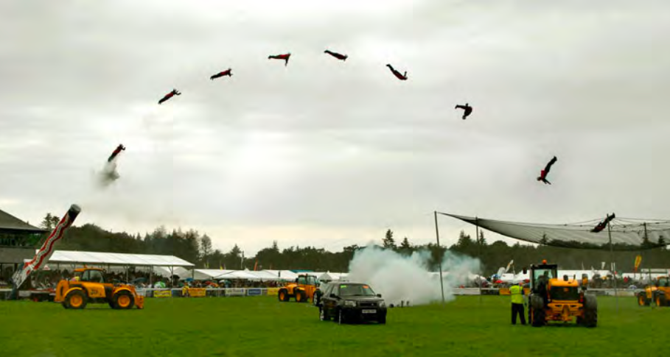
Projectile Motion

Slide 6
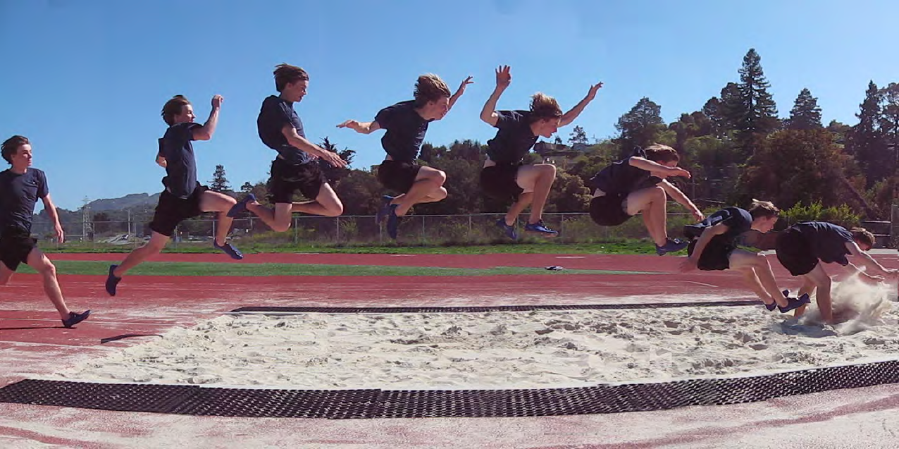
Who is in the air longer?
Notes:
6

Slide 7

Spud Webb
At only 5’7”, he won the 1986 NBA Slam Dunk Championship.

Slide 8
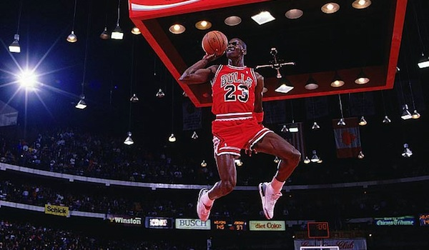
Michael ‘Air’ Jordan
Won Slam Dunk Constest in 1987 and 1988.

Slide 9
Dunk Videos
Spud:
http://www.youtube.com/watch?v=8mY6-ycnwZ8
Jordan:
http://www.youtube.com/watch?v=sUz3ZYfoNxo

Slide 10
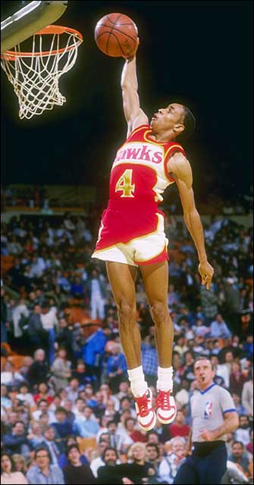
Spud Webb has a better hang time.
In Fact:
Spud Webb holds the vertical jump world record at an amazing 1.25 m.

Slide 11
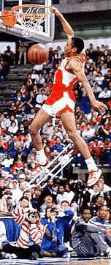
So just how much “hang time” did he get?
y = ½at²
g
t = √2y
= √2(-1.25)
g
- 9.8
= .50 s
double it
1 second record hang time

Slide 12
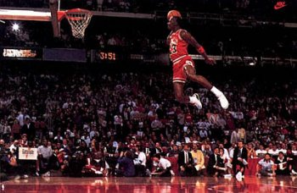
Jordan had a longer jump, but he was not in the air as long as Spud!
Hang time depends only on the jumper’s vertical speed at launch… not horizontal.
Horizontal speed remains constant but vertical speed undergoes acceleration.

Slide 13
Amazing facts!
If a gun is fired horizontally, and at the same time a bullet is dropped from the same height. They both hit the ground at the same time.

Slide 14

Myth Busters Bullet Clip
http://www.youtube.com/watch?v=D9wQVIEdKh8

Slide 15
Amazing facts!

Slide 16
Amazing facts!

Slide 17
Amazing facts!

Slide 18
Amazing facts!
Why?

Slide 19
Vertical and horizontal
Their vertical motion can be considered separate from their horizontal motion.

Slide 20
Vertical and horizontal
Vertically, they both have zero initial velocity and accelerate downwards at 9.8 m.s⁻². The time to fall the same vertical distance is therefore the same.

Slide 21
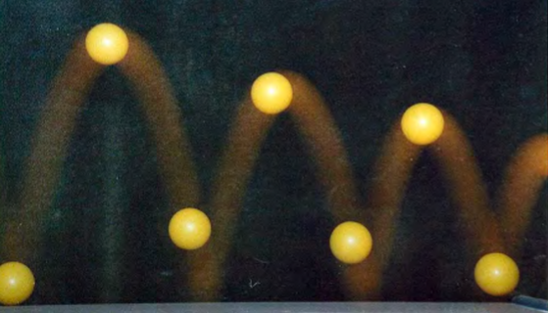
Rules
There are only really a few rules:
All projectiles are freefalling objects
The horizontal motion is totally unaffected by the freefall motion!
Since there are no forces acting on it, horizontal motion is at constant speed!

Slide 22
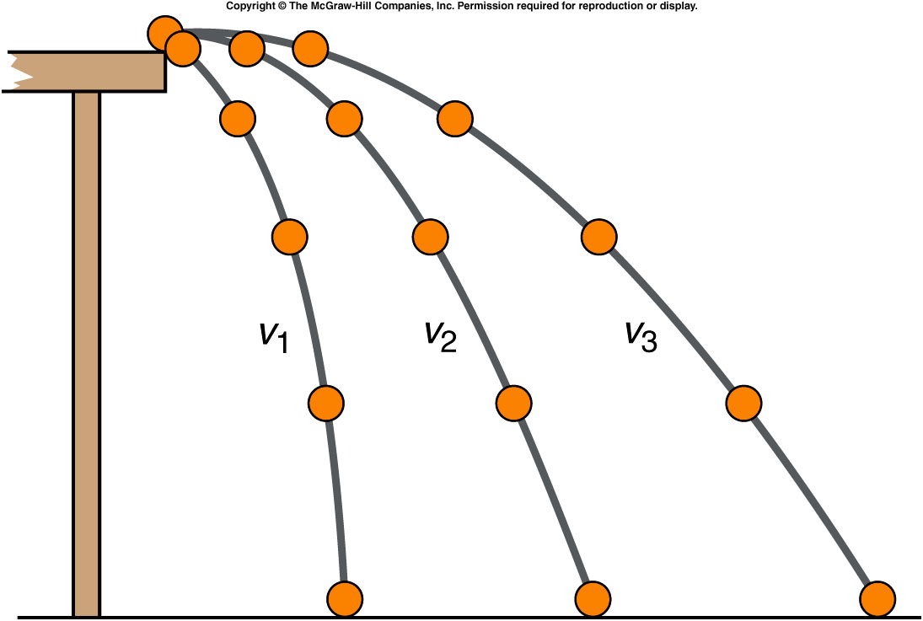
Horizontal Projectiles
Horizontal Projectiles are easiest to work with
only formula used in horizontal (x) direction is:
v_{x} = d_{x} / t
constant speed
Notes:
note the distance traveled in each is the same in the x direction

Slide 23
Horizontal Projectiles
vertical (y) direction is just freefall
all of the initial velocity is in the x direction
So,
v_{iy} = 0
since v_{iy} is in freefall,
a = -9.8 m/s²

Slide 24


No wonder the bird is angry!
v_{h}
Imagine a bird being kicked horizontally off the top of a cliff (with an initial velocity v_{h}).

Slide 25
Parabola
Assuming that there is negligible air resistance, he or she falls in the path of a parabola.

Slide 26

Parabola

Slide 27
Parabola
Why?

Slide 28
Why a parabola?
We can consider his motion to be the sum of his horizontal motion and vertical motion.
We can treat these separately
v_{h}

Slide 29
Horizontal motion
Assuming no air resistance, there are no horizontal forces.
This means horizontally
the bird moves with
constant speed v_{h}
v_{h}
Horizontal distance travelled (x) = v_{h}t

Slide 30
Vertical motion
Assuming no air resistance, there is constant force downwards (gravity).
This means vertically the bird moves with constant acceleration g = 9.8 m.s⁻²
Vertical distance travelled (y) = ½gt²

Slide 31
Parabolic motion
Since y = ½gt² and x = v_{h}t, solve for t in terms of x and v_{h}, then substitute for t which results in an x and y funtion:
y = ½gx²/v_{h}²
You may recognize this as the formula of a parabola.

Slide 32
Example 1
An angry bird is kicked off the top of a cliff with an initial horizontal velocity of 5 m.s⁻¹. If the cliff is 30 m high, how far from the cliff bottom will the bird hit the ground?
5 m.s⁻¹
30 m

Slide 33
Example 1
Looking at vertical motion first:
g = 9.8 ms⁻², y = 30 m, t = ?
y = ½ gt²
30 = ½ x 9.8 x t²
t² = 6.1
t = 2.47 s
The bird hits the ground after 2.47 seconds
5 m.s⁻¹
30 m

Slide 34
Example 1
Now look at horizontal motion:
Constant speed (horizontally) = 5 m.s⁻¹
Time of fall = 2.47 seconds
Horizontal distance travelled = speed x time
Horizontal distance travelled = 5 x 2.47
= 12.4 m The bird hits the ground 12.4 metres from the base of the cliff
5 m.s⁻¹
30 m

Slide 35
Example 2
An angry bird is kicked off the top of a cliff with an initial horizontal velocity of 10 m.s⁻¹. If the cliff is 49 m high, how far from the cliff bottom will the bird hit the ground?
10 m.s⁻¹
49 m

Slide 36
Example 2
Looking at vertical motion first:
g = 9.8 ms⁻², y = 49 m, t = ?
y = ½ gt²
49= ½ x 9.8 x t²
t² = 10
t = 3.16s
The bird hits the ground after 3.16 seconds
10 m.s⁻¹
49 m

Slide 37
Example 2
Now look at horizontal motion:
Constant speed (horizontally) = 10 ms⁻¹
Time of fall = 3.16 seconds
Horizontal distance travelled = speed x time
Horizontal distance travelled
= 10 x 3.16
= 31.6 m
The bird hits the ground 31.6 meters from the base of the cliff
10 m.s⁻¹
49 m

Slide 38
Example 3
An angry bird is kicked off the top of a cliff with an initial horizontal velocity of 20 m.s⁻¹. If the cliff is 44.1 m high, how far from the cliff bottom will the bird hit the ground?
20 m.s⁻¹
44.1 m

Slide 39
Example
Looking at vertical motion first:
g = 9.8 ms⁻², y = 44.1 m, t = ?
y = ½ gt²
44.1 = ½ x 9.8 x t²
t² = 9
t = 3 s
The bird hits the ground after 3 seconds
20 m.s⁻¹
44.1 m

Slide 40
Example
Now look at horizontal motion:
Constant speed (horizontally) = 20 m.s⁻¹
Time of fall = 3 seconds
Horizontal distance travelled = speed x time
Horizontal distance travelled = 3 x 20
= 60 m The bird hits the ground 60 metres from the base of the cliff
20 m.s⁻¹
44.1 m

Slide 41
Example 4
An angry bird is kicked off the top of a cliff with an initial horizontal velocity of 30 m.s⁻¹. If the cliff is 98 m high, how far from the cliff bottom will the bird hit the ground?
30 m.s⁻¹
98 m

Slide 42
Example 4
Looking at vertical motion first:
g = 9.8 ms⁻², y = 98 m, t = ?
y = ½ gt²
98 = ½ x 9.8 x t²
t² = 20
t = 4.47s
The bird hits the ground after 4.47 seconds
30 m.s⁻¹
98 m

Slide 43
Example
Now look at horizontal motion:
Constant speed (horizontally) = 30 m.s⁻¹
Time of fall = 4.47 seconds
Horizontal distance travelled = speed x time
Horizontal distance travelled
= 4.47 x 30
= 134 m
The bird hits the ground 134 metres from the base of the cliff
30 m.s⁻¹
98 m

Slide 44
Closure
What are the steps for calculating the vertical distance traveled of a free falling object?
What is the formula to used to calculate time in the air?
What is the formula for calculating vertical distance traveled?

Slide 45
Additional EXAMPLE
A person decides to fire a rifle horizontally at a bull’s-eye. The speed of the bullet as it leaves the barrel of the gun is 890 m/s. He’s new to the ideas of projectile motion so doesn’t aim high and the bullet strikes the target 1.7 cm below the center of the bull’s-eye.
What is the horizontal distance between the rifle and the bull’ s-eye?
start by drawing a picture:
label the explicit givens

Slide 46
Example
What is the horizontal distance between the rifle and the bull’ s-eye?
givens (separate by direction):
X | Y
want:
horizontal distance

Slide 47
Example
which equation do we use?
use to find time
rewrite equation for t

Slide 48
Example
Use t and v_{x} to solve for d_{x}

